Slide 1



MY ID Pro
Digital Agency
NO.: 00B14/C01
MD SHAHZAR IDRIS
Strategic Integration Agent
Strategic Integration Partner
MY ID PRO DIGITAL AGENCY
(SSM Registration No.: IP0606816H / 202503078803)
Suite 4801-1-1, Block C, CBD Perdana 1
Persiaran Flora, Off Persiaran Multimedia
63000 Cyberjaya, Selangor, MALAYSIA
HP +60.14.9666.950
Emel sia@myidprodigital.com
Web www.myidprodigital.com

Slide 2
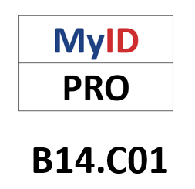
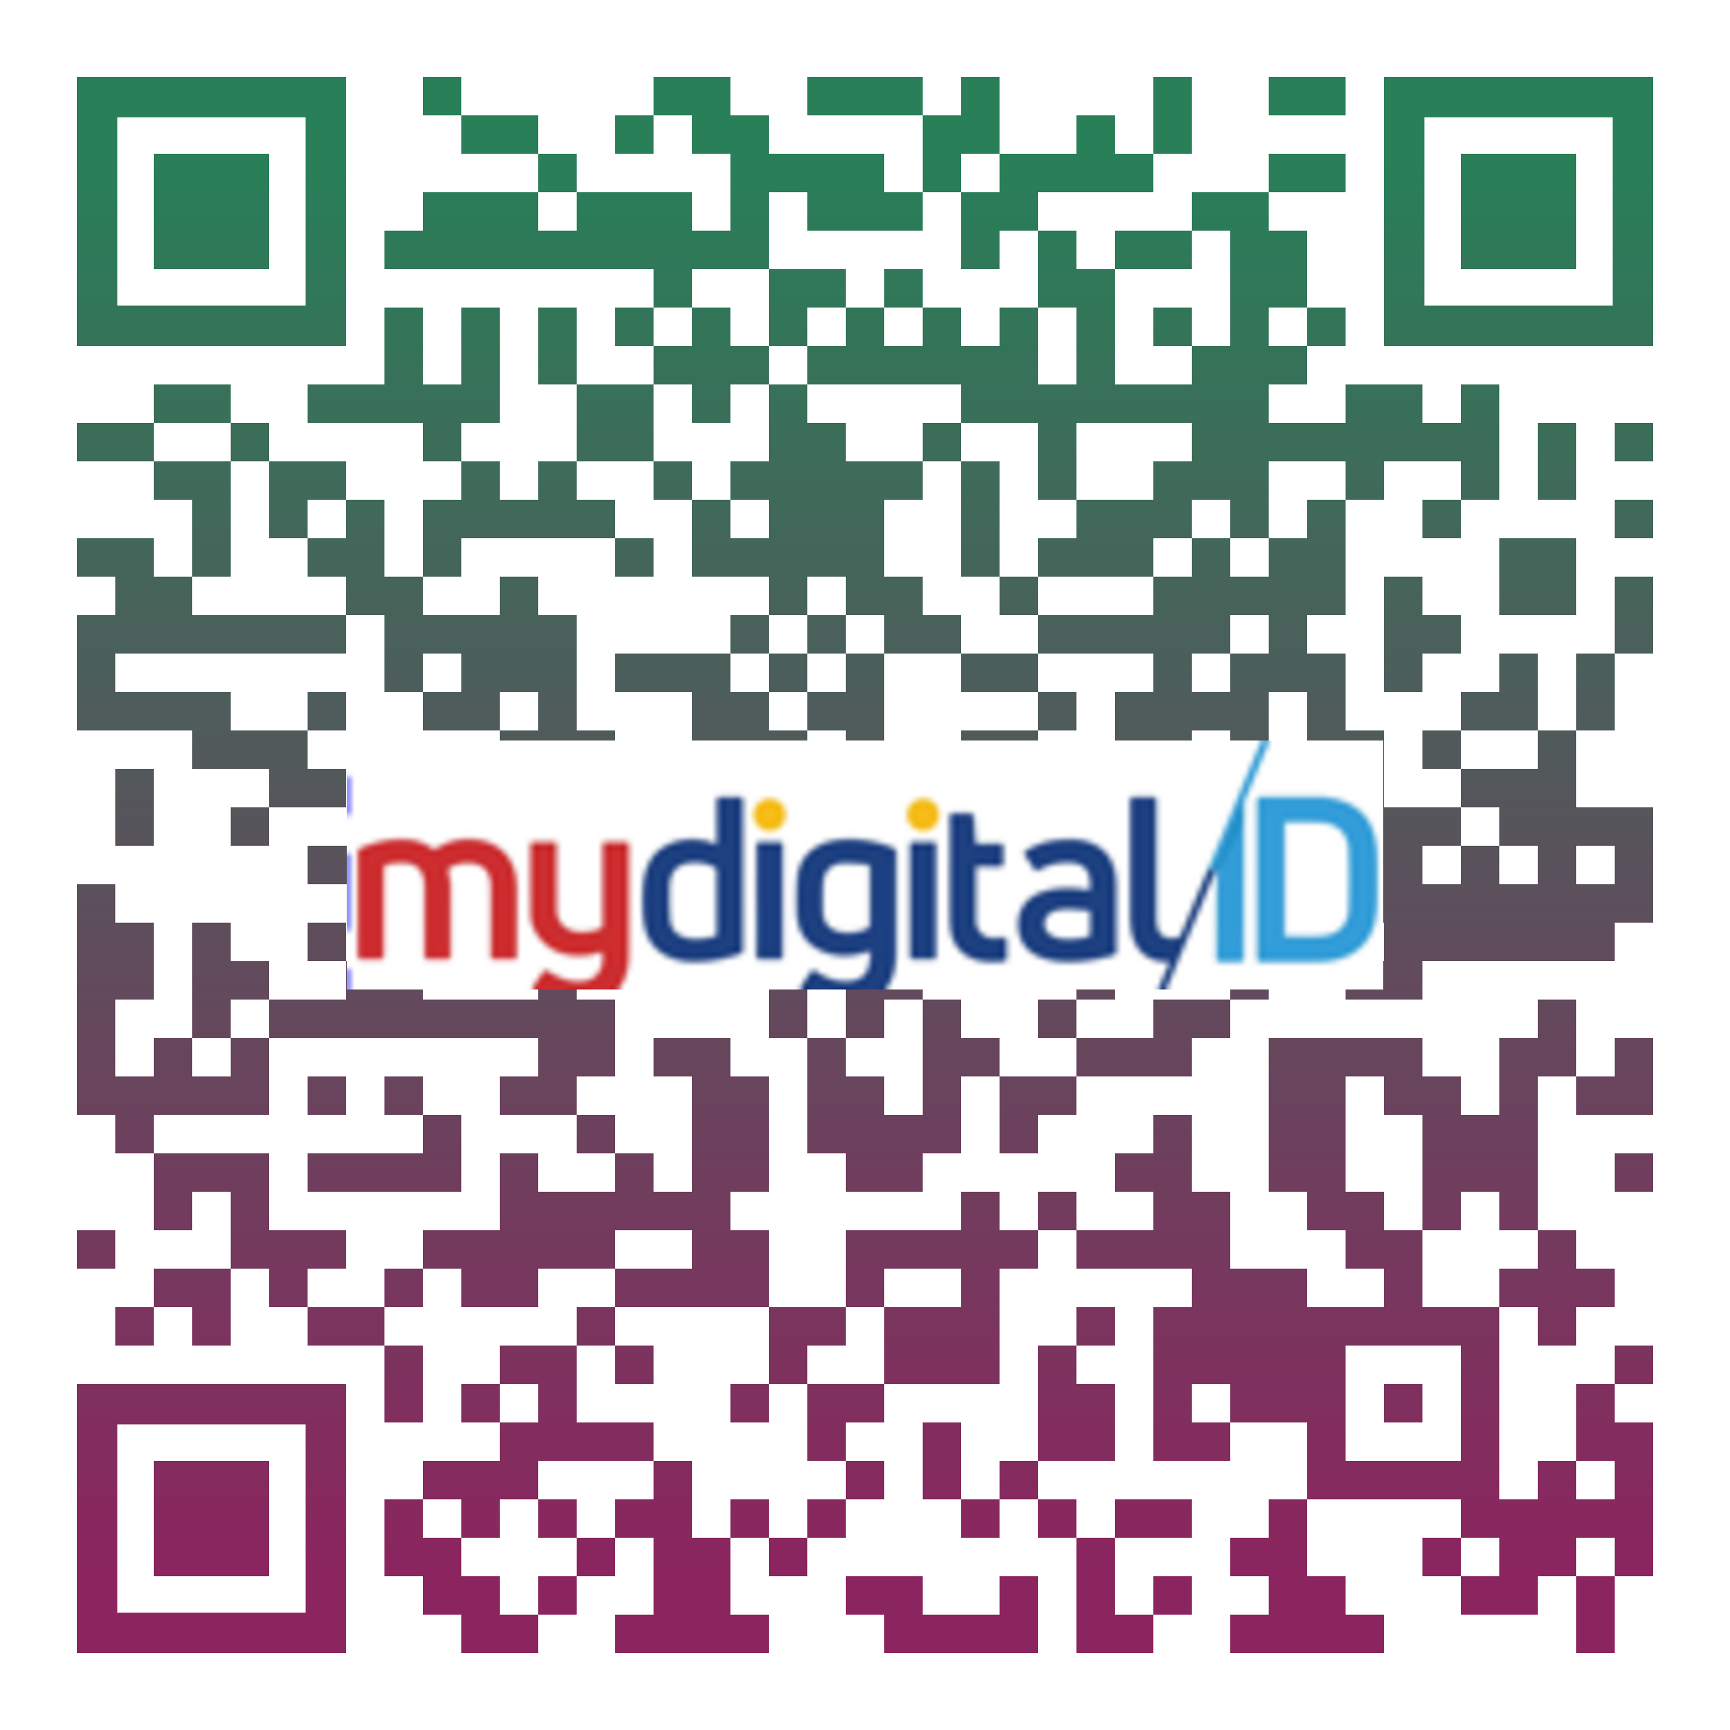

MYIDPRO OOB14/C01 MSSB | PT SRI DINISTRIWARDANA RESOURCES [003648897A / 202403247936]
Wakil Rasmi Pelaksana MSSB MyID Pro

